Slide 1
DYSANOS
Generative Smooth Arbitrage-free Non-parametric Option Surfaces
Hans Buehler, joint work with Blanka Horvath, Anastasis Kratsios
University of Oxford, Institute for Mathematics
hans.buehler@maths.ox.ac.uk
International Conference on Computational Finance 2026
London, September 2nd, 2026

Slide 2
Problem Statement
Historic Quantitative Finance Model Development
  Models are solvable – aim is to “calibrate” a model to market.
  Dynamics are an afterthought.
  Local-Vol overlay used to “fit” the market.
  Works well but requires human intervention.
Program:
  Fit a strictly arbitrage free model to historic market data.
  Turn it into a generative option market model.
  Remove the drift to get a risk-neutral model.

Slide 3
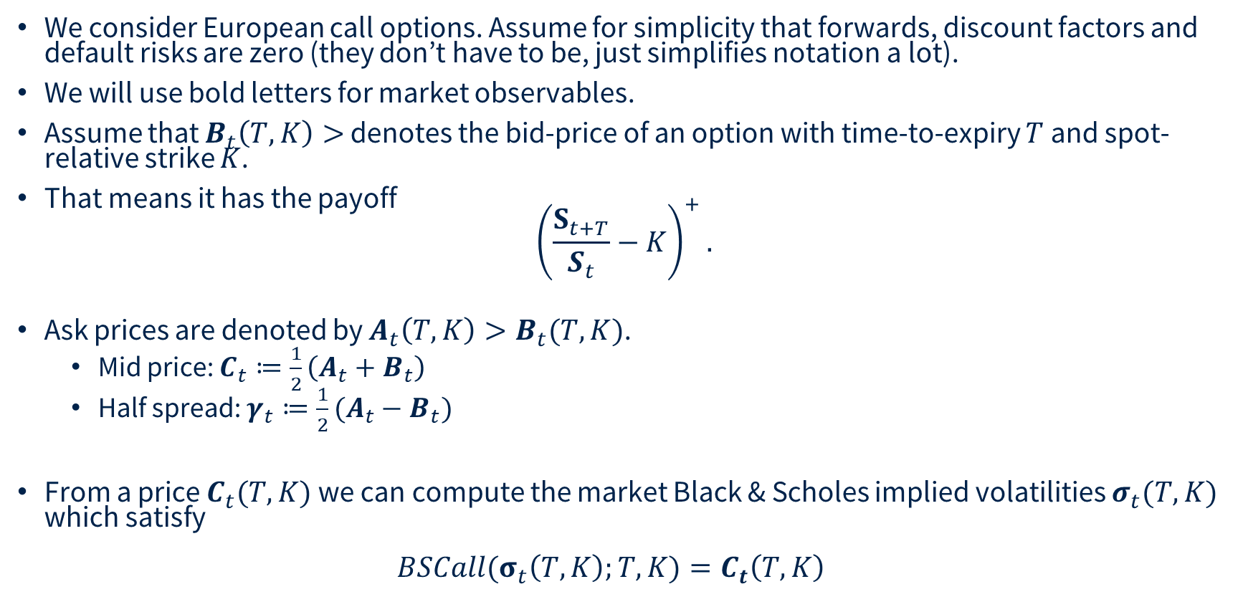
Option Markets
We consider European call options. Assume for simplicity that forwards, discount factors and default risks are zero (they don’t have to be, just simplifies notation a lot).
We will use bold letters for market observables.
Assume that $B_{t}\left(T,K\right)>$ denotes the bid-price of an option with time-to-expiry $T$ and spot-relative strike $K$.
That means it has the payoff
${\left(\frac{S_{t+T}}{S_{t}}−K\right)}^{+}.$
Ask prices are denoted by $A_{t}\left(T,K\right)>B_{t}(T,K)$.
  Mid price: $C_{t}≔\frac{1}{2}\left(A_{t}+B_{t}\right)$
  Half spread: $γ_{t}≔\frac{1}{2}(A_{t}−B_{t})$
From a price $C_{t}(T,K)$ we can compute the market Black & Scholes implied volatilities $σ_{t}(T,K)$ which satisfy
${BSCall(σ}_{t}\left(T,K\right);T,K)=C_{t}\left(T,K\right)$

Slide 4

Option Markets

Slide 5
Option Markets
Problem
  We would like to simulate such markets, ideally under the risk-neutral measure.
Why not use Dupire’s Implied Vol as “code book” directly ?
  No known way to ensure absence of static arbitrage.
  There cannot be a risk-neutral measure if the market is arbitrageable.
  In practice, our method to find such measures blows up numerically.
Parameterizing local vol as “code book” ?
  Resulting call prices are always arbitrage-free
  Continuous time/space “Dupire” too hard to handle:
    Requires arb-free interpolation of real market data so it can be computed
    Pricing “in simulation” on a GPU requires solving forward-PDEs.
  Let us use smoothed discrete local volatility then – SANOS.

Slide 6
SANOS
Smooth Arbitrage-free Non-parametric Option Surfaces
Joint work with Blanka Horvath, Anastasis Kratsios, Yannick Limmer, Raeid Saqur

Slide 7
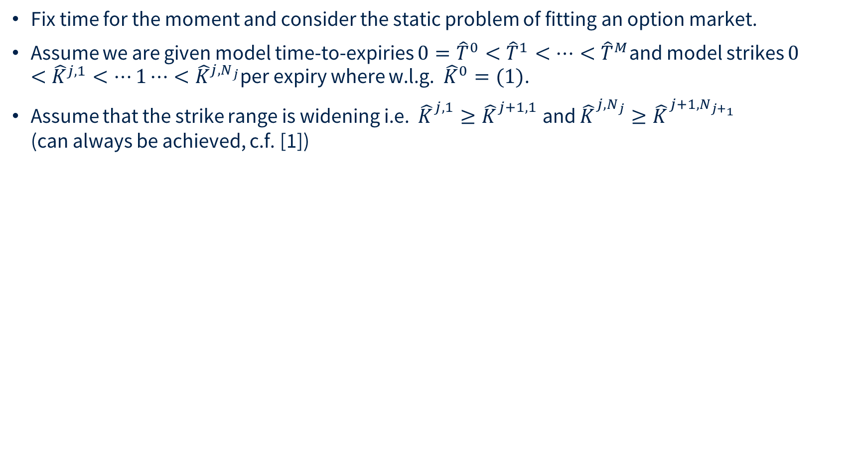
SANOS
Fix time for the moment and consider the static problem of fitting an option market.
Assume we are given model time-to-expiries $0={\hat{T}}^{0}<{\hat{T}}^{1}<⋯<{\hat{T}}^{M}$and model strikes $0<{\hat{K}}^{j,1}<⋯1⋯<{\hat{K}}^{j,N_{j}}$per expiry where w.l.g. ${\hat{K}}^{0}=(1)$.
Assume that the strike range is widening i.e. ${\hat{K}}_{}^{j,1}≥{\hat{K}}_{}^{j+1,1}$ and ${\hat{K}}_{}^{j,N_{j}}≥{\hat{K}}_{}^{{j+1,N}_{j+_{1}}}$
(can always be achieved, c.f. [1])
__
[1] Buehler et al, 2026 SANOS https://arxiv.org/pdf/2601.11209

Slide 8
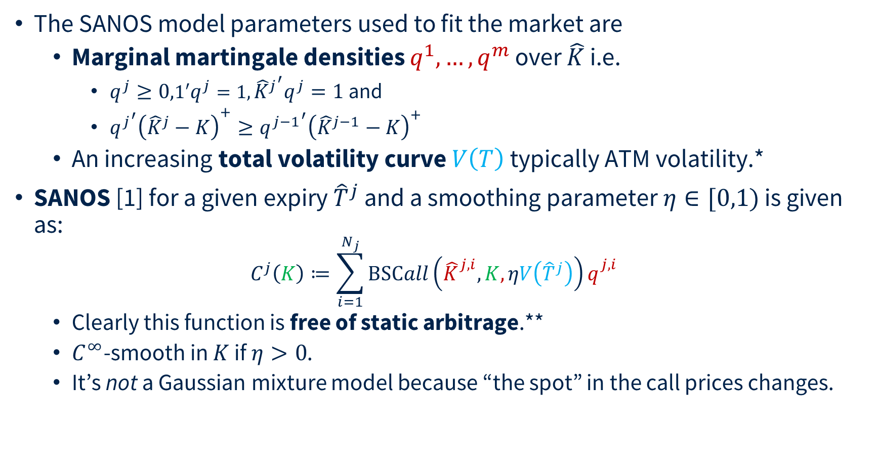
SANOS
The SANOS model parameters used to fit the market are
  Marginal martingale densities $q^{1},…,q^{m}$ over $\hat{K}$ i.e.
    $q^{j}≥0,1′q^{j}=1,{{\hat{K}}^{j}}^{′}q^{j}=1$ and
    ${{q^{j}}^{′}\left({\hat{K}}^{j}−K\right)}^{+}≥{q^{j−1}}^{′}{\left({\hat{K}}^{j−1}−K\right)}^{+}$
  An increasing total volatility curve $V\left(T\right)$ typically ATM volatility.*
SANOS [1] for a given expiry ${\hat{T}}^{j}$ and a smoothing parameter $η∈[0,1)$ is given as:
$C^{j}\left(K\right)≔\sum_{i=1}^{N_{j}}{BSCall\left({\hat{K}}_{}^{j,i},K,ηV\left({\hat{T}}^{j}\right)\right)q_{}^{j,i}}$
  Clearly this function is free of static arbitrage.**
  $C^{∞}$-smooth in $K$ if $η>0$.
  It’s not a Gaussian mixture model because “the spot” in the call prices changes.
__
[1] Buehler et al, 2026 SANOS https://arxiv.org/pdf/2601.11209
* Using volatility instead of variance avoids taking square roots (and therefore derivatives thereof) of a variable which can become zero in torch.
** In the sense of the first fundamental theorem of asset pricing, e.g. existence of an integrable positive variable $Z_{j}$such that $C^{j}\left(K\right)=E\left[{\left(Z_{j}−K\right)}^{+}\right].$

Slide 9
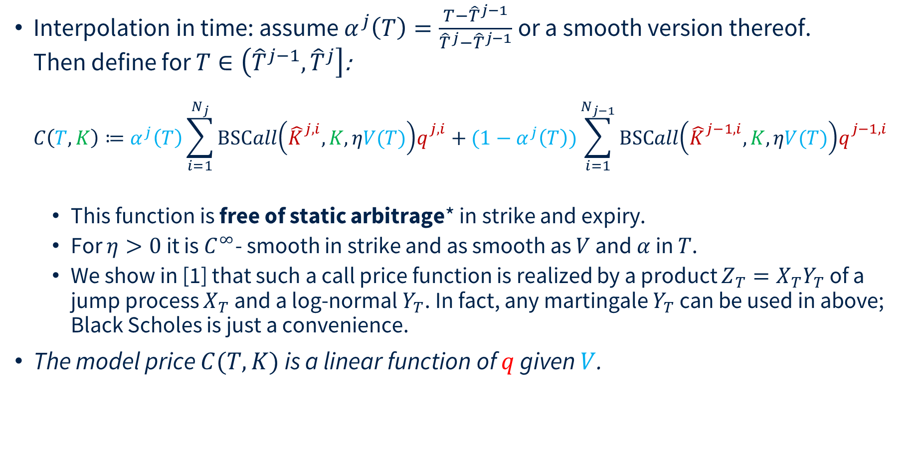
SANOS
Interpolation in time: assume $α^{j}\left(T\right)=\frac{T−{\hat{T}}^{j−1}}{{\hat{T}}^{j}−{\hat{T}}^{j−1}}$ or a smooth version thereof.
Then define for $T∈\left({\hat{T}}^{j−1},{\hat{T}}^{j}\right]$:
$C\left(T,K\right)≔α^{j}\left(T\right)\sum_{i=1}^{N_{j}}{BSCall\left({\hat{K}}_{}^{j,i},K,ηV(T)\right)q_{}^{j,i}}+(1−α^{j}\left(T\right))\sum_{i=1}^{N_{j−1}}{BSCall\left({\hat{K}}_{}^{j−1,i},K,ηV(T)\right)q_{}^{j−1,i}}$
  This function is free of static arbitrage* in strike and expiry.
  For $η>0$ it is $C^{∞}$- smooth in strike and as smooth as $V$ and $α$ in $T$.
  We show in [1] that such a call price function is realized by a product ${Z_{T}=X}_{T}Y_{T}$ of a jump process $X_{T}$ and a log-normal $Y_{T}$. In fact, any martingale $Y_{T}$ can be used in above; Black Scholes is just a convenience.
The model price $C(T,K)$ is a linear function of $q$ given $V$.
__
[1] Buehler et al, 2026 SANOS https://arxiv.org/pdf/2601.11209
* i.e. first fundamental theorem of asset pricing: existence of an integrable positive martingale $Z_{T}$such that $C\left(T,K\right)=E\left[{\left(Z_{T}−K\right)}^{+}\right].$

Slide 10

Fitting to the Market
For the $ℓ$^{th} market option the price $C^{ℓ}≔C(T^{ℓ},K^{ℓ})$ is a linear function of $q$.
Then [1] we may find an arbitrage-free smooth interpolation of discrete call prices $C_{j}^{i}$ jointly across all strikes and expiries by solving a linear problem
$\min_{q}{:}\sum_{ℓ }{\frac{1}{γ_{ℓ}^{i}}\left\{{\left(C_{}^{ℓ}−A_{}^{ℓ}\right)}^{+}+{\left(B_{}^{ℓ}−C_{}^{ℓ}\right)}^{+}+ε \left|C_{}^{ℓ}−M_{}^{ℓ}\right|\right\}}$
with linear constraints:
  $q_{j}≥0$, $1^{′}q^{j}=1$,${{\hat{K}}^{j}}^{′}q^{j}=1$
  ${q^{j}′\left({\hat{K}}^{j}−{\hat{K}}_{}^{j,i}\right)}^{+}≥{q^{j−1}}^{′}{\left({\hat{K}}^{j−1}−{\hat{K}}_{}^{j,i}\right)}^{+}$for all $i,j$.
Straightforward global fit with linear programming.
__
[1] Buehler et al, 2026 SANOS https://arxiv.org/pdf/2601.11209

Slide 11
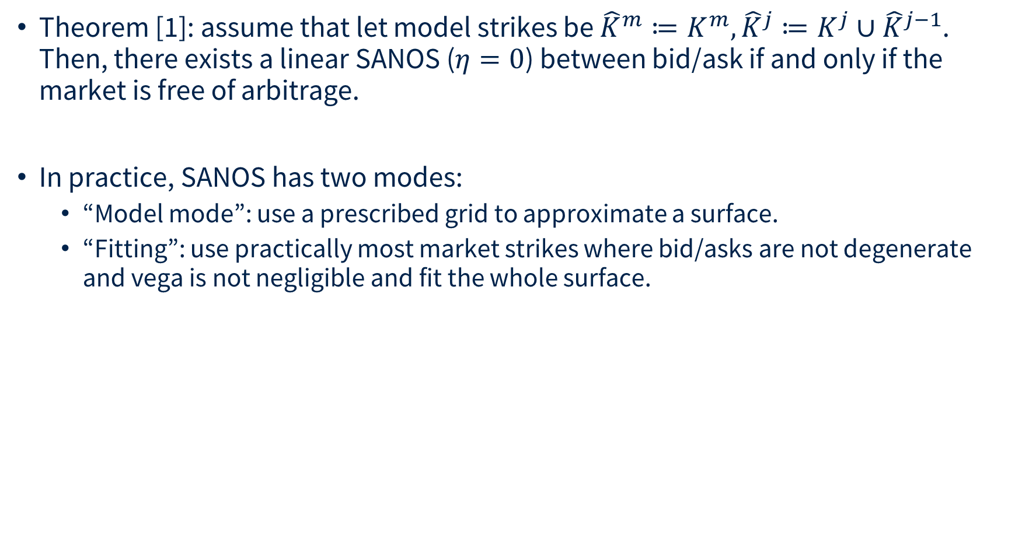
SANOS
Theorem [1]: assume that let model strikes be ${\hat{K}}^{m}≔K^{m},{\hat{K}}^{j}≔K^{j}∪{\hat{K}}^{j−1}$.
Then, there exists a linear SANOS ($η=0$) between bid/ask if and only if the market is free of arbitrage.
In practice, SANOS has two modes:
  “Model mode”: use a prescribed grid to approximate a surface.
  “Fitting”: use practically most market strikes where bid/asks are not degenerate and vega is not negligible and fit the whole surface.
__
[1] Buehler et al, 2026 SANOS https://arxiv.org/pdf/2601.11209
* i.e. first fundamental theorem of asset pricing: existence of an integrable positive martingale $Z_{T}$such that $C\left(T,K\right)=E\left[{\left(Z_{T}−K\right)}^{+}\right].$

Slide 12


Fitting to the Market
Fitted 1000 options within 2 ATM implied volatility standard deviations which had a Vega/sqrtT of at least 0.1% on 2025-05-06 across all 48 expiries from 1D to 657 business days.
Options were chosen by closeness to ATM. The model fitted 91.4% of all options within bid/ask. Of those options not fitted the median error is just 21% of half spread.
The fit took sub-seconds on a desktop PC.

Slide 13
DYSANOS
Generative Smooth Arbitrage-free Non-parametric Option Surfaces [1]
__
[1] Hans Buehler et al. DYSANOS Generative Dynamic Smooth Arbitrage-free Non-parametric Option Surfaces, 2026 https://arxiv.org/abs/2608.12587

Slide 14
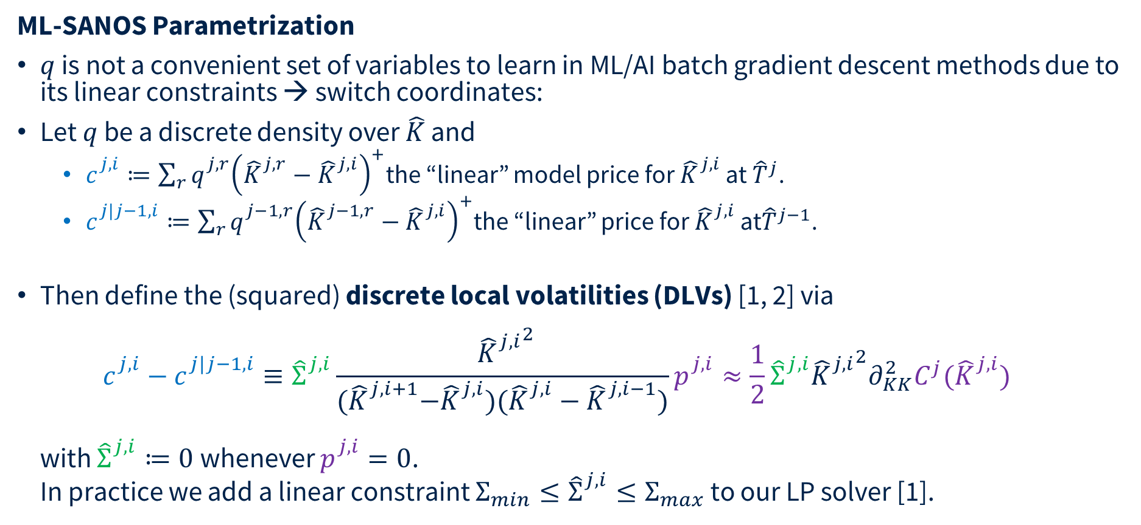
DYSANOS
ML-SANOS Parametrization
$q$ is not a convenient set of variables to learn in ML/AI batch gradient descent methods due to its linear constraints → switch coordinates:
Let $q$ be a discrete density over $\hat{K}$ and
  $c_{}^{j,i}≔\sum_{r}{q_{}^{j,r}{\left({\hat{K}}_{}^{j,r}−{\hat{K}}_{}^{j,i}\right)}^{+}}$the “linear” model price for ${\hat{K}}_{}^{j,i}$ at ${\hat{T}}^{j}$.
  $c_{}^{j|j−1,i}≔\sum_{r}{q_{}^{j−1,r}{\left({\hat{K}}_{}^{j−1,r}−{\hat{K}}_{}^{j,i}\right)}^{+}}$the “linear” price for ${\hat{K}}_{}^{j,i}$ at${\hat{T}}^{j−1}$.
Then define the (squared) discrete local volatilities (DLVs) [1, 2] via
$c_{}^{j,i}−c_{}^{j|j−1,i}≡{\hat{Σ}}_{}^{j,i}\frac{ {{\hat{K}}_{}^{j,i}}^{2}}{{(\hat{K}}_{}^{j,i+1}−{\hat{K}}_{}^{j,i})({\hat{K}}_{}^{j,i}−{\hat{K}}_{}^{j,i−1})}p_{}^{j,i}≈\frac{1}{2}{\hat{Σ}}_{}^{j,i}{{\hat{K}}_{}^{j,i}}^{2}∂_{KK}^{2}C^{j}({\hat{K}}_{}^{j,i})$
with ${\hat{Σ}}_{}^{j,i}≔0$ whenever $p_{}^{j,i}=0$.
In practice we add a linear constraint ${Σ_{min}≤\hat{Σ}}_{}^{j,i}≤Σ_{max}$ to our LP solver [1].
__
[1] Hans Buehler and Evgeny Ryskin. Discrete local volatility for large time steps (extended version). https://papers.ssrn.com/abstract=2642630 2015.
[2] Finite Difference Based Calibration and Simulation Andreasen et al, 2010 https://papers.ssrn.com/sol3/papers.cfm?abstract_id=1697545

Slide 15
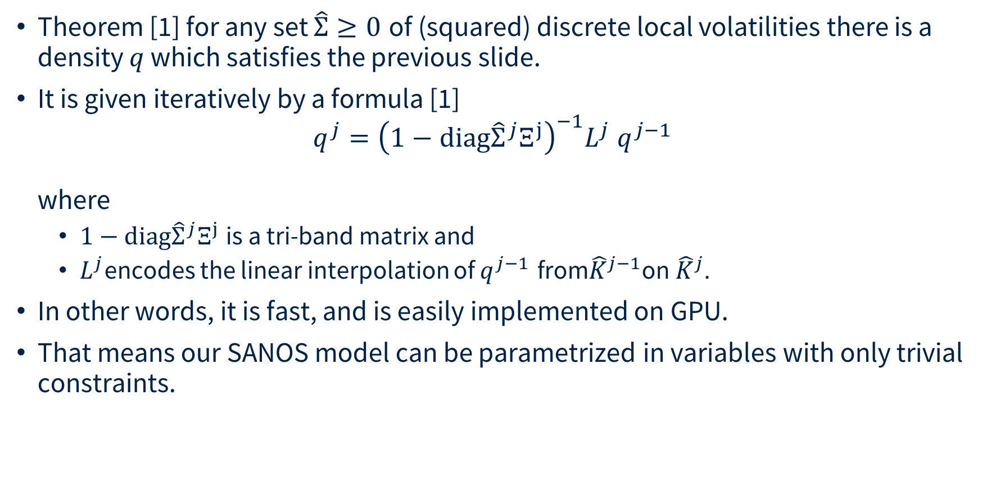
DYSANOS
Theorem [1] for any set $\hat{Σ}≥0$ of (squared) discrete local volatilities there is a density $q$ which satisfies the previous slide.
It is given iteratively by a formula [1]
$q^{j}={\left(1−\text{diag}{\hat{Σ}}^{j}Ξ^{j}\right)}^{−1}L^{j} q^{j−1}$
where
  $1−\text{diag}{\hat{Σ}}^{j}Ξ^{j}$is a tri-band matrix and
  $L^{j}$encodes the linear interpolation of $q^{j−1}$ from${\hat{K}}^{j−1}$on${ \hat{K}}^{j}$.
In other words, it is fast, and is easily implemented on GPU.
That means our SANOS model can be parametrized in variables with only trivial constraints.
__
[1] Hans Buehler and Evgeny Ryskin. Discrete local volatility for large time steps (extended version). https://papers.ssrn.com/abstract=2642630 2015.

Slide 16
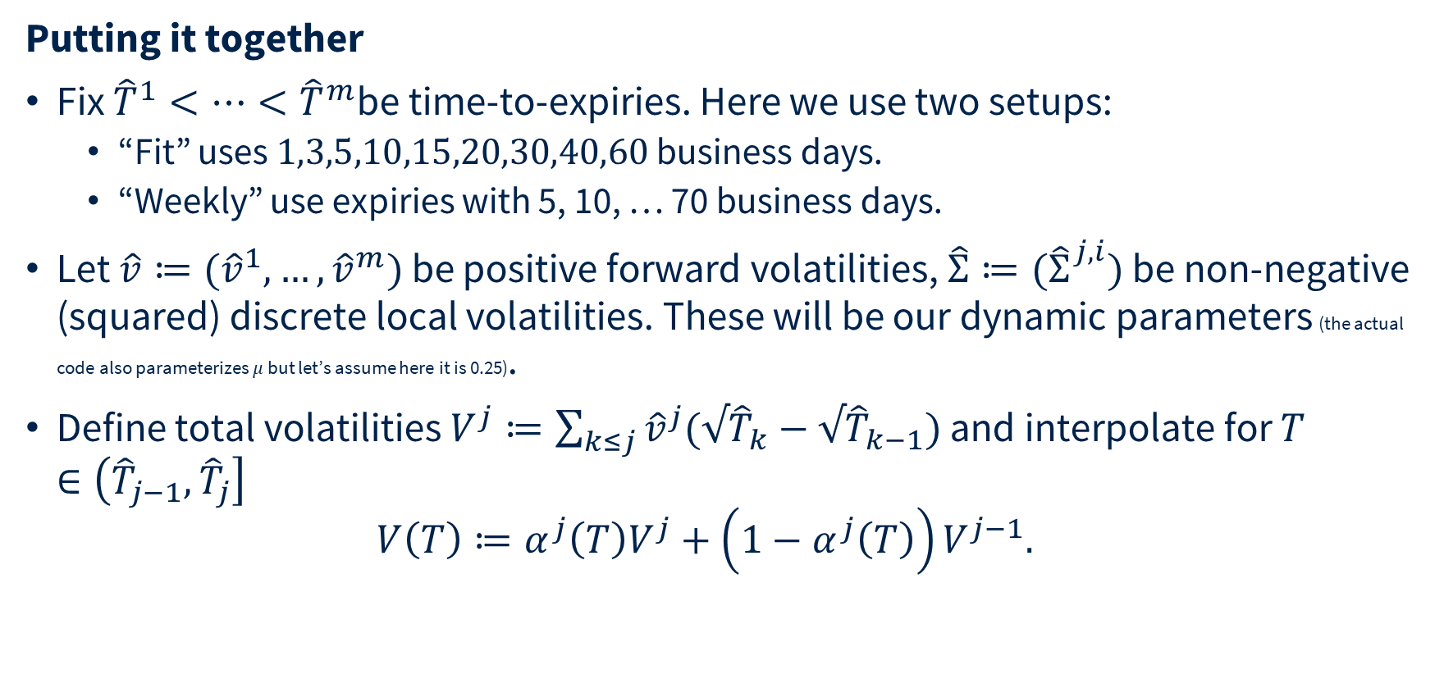
DYSANOS
Putting it together
Fix ${\hat{T}}^{1}<⋯<{\hat{T}}^{m}$be time-to-expiries. Here we use two setups:
  “Fit” uses $1,3,5,10,15,20,30,40,60$ business days.
  “Weekly” use expiries with 5, 10, … 70 business days.
Let $\hat{v}≔({\hat{v}}^{1},…,{\hat{v}}^{m})$ be positive forward volatilities, ${\hat{Σ}≔(\hat{Σ}}_{}^{j,i})$ be non-negative (squared) discrete local volatilities. These will be our dynamic parameters (the actual code also parameterizes $μ$ but let’s assume here it is 0.25).
Define total volatilities $V^{j}≔\sum_{k≤j}{{\hat{v}}^{j}(√{\hat{T}}_{k}−{√\hat{T}}_{k−1})}$ and interpolate for $T∈\left({\hat{T}}_{j−1},{\hat{T}}_{j}\right]$
$V\left(T\right)≔α^{j}\left(T\right)V^{j}+\left(1−α^{j}\left(T\right)\right)V^{j−1}.$

Slide 17
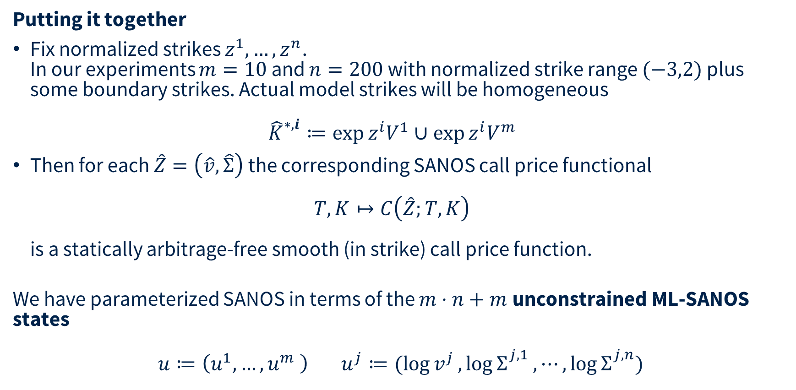
DYSANOS
Putting it together
Fix normalized strikes $z^{1},…,z^{n}$.
In our experiments $m=10$ and $n=200$ with normalized strike range $(−3,2)$ plus some boundary strikes. Actual model strikes will be homogeneous
${\hat{K}}_{}^{∗,i}≔\exp{z^{i}V^{1}}∪\exp{z^{i}V^{m}}$
Then for each $\hat{Z}=\left(\hat{v},\hat{Σ}\right)$ the corresponding SANOS call price functional
$T,K↦C\left(\hat{Z};T,K\right)$
is a statically arbitrage-free smooth (in strike) call price function.
We have parameterized SANOS in terms of the $m⋅n+m$unconstrained ML-SANOS states
$$u≔\left(u^{1},…,u^{m} \right) u^{j}≔(\log{v^{j}},\log{Σ_{}^{j,1}},⋯,\log{Σ_{}^{j,n}})$$

Slide 18
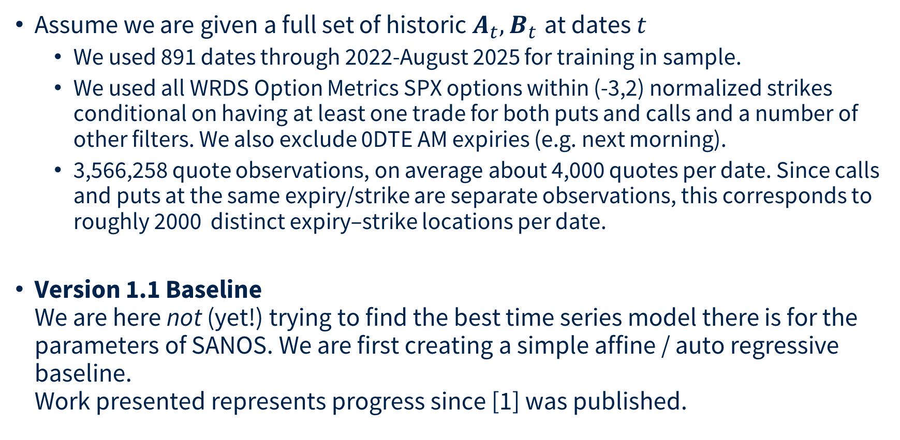
Linear Auto Regressive DYSANOS
Assume we are given a full set of historic $A_{t},B_{t}$ at dates $t$
  We used 891 dates through 2022-August 2025 for training in sample.
  We used all WRDS Option Metrics SPX options within (-3,2) normalized strikes conditional on having at least one trade for both puts and calls and a number of other filters. We also exclude 0DTE AM expiries (e.g. next morning).
  3,566,258 quote observations, on average about 4,000 quotes per date. Since calls and puts at the same expiry/strike are separate observations, this corresponds to roughly 2000 distinct expiry–strike locations per date.
Version 1.1 Baseline
We are here not (yet!) trying to find the best time series model there is for the parameters of SANOS. We are first creating a simple affine / auto regressive baseline.
Work presented represents progress since [1] was published.
__
[1] Hans Buehler et al. DYSANOS Generative Dynamic Smooth Arbitrage-free Non-parametric Option Surfaces, 2026 https://arxiv.org/abs/2608.12587

Slide 19
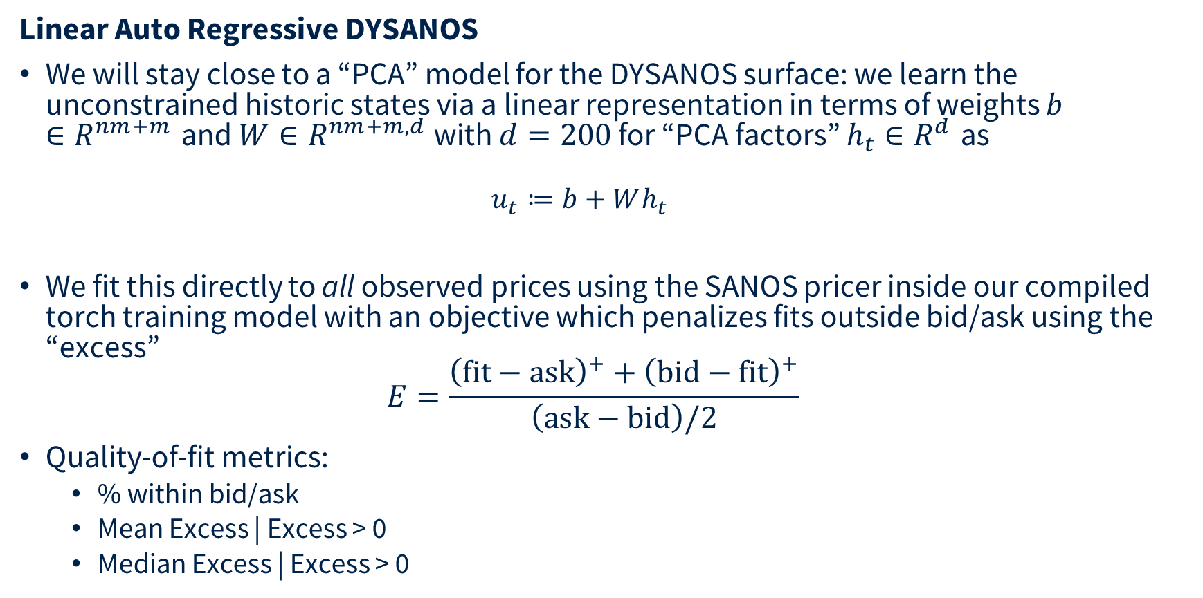
Linear Auto Regressive DYSANOS
Linear Auto Regressive DYSANOS
We will stay close to a “PCA” model for the DYSANOS surface: we learn the unconstrained historic states via a linear representation in terms of weights $b∈R^{nm+m}$ and $W∈R^{nm+m,d}$ with $d=200$ for “PCA factors” $h_{t}∈R^{d}$ as
  $$u_{t}≔b+Wh_{t}$$
We fit this directly to all observed prices using the SANOS pricer inside our compiled torch training model with an objective which penalizes fits outside bid/ask using the “excess”
$E=\frac{{\left(\text{fit}−\text{ask}\right)}^{+}+{\left(\text{bid}−\text{fit}\right)}^{+}}{\left(\text{ask}−\text{bid}\right)/2}$
Quality-of-fit metrics:
  % within bid/ask
  Mean Excess | Excess > 0
  Median Excess | Excess > 0

Slide 20
Linear Auto Regressive DYSANOS
Weekly Model
First column: we compare the fit to the full market vs plain SANOS for the same model geometry. We get essentially the same result.
Second column: the model does not fit well for market expiries before the first model expiry.
Statistic | Market ≤ Last Model Expiry | First Model ≤ Market ≤ Last Model Expiry
# quotes | 3,569,180 | 3,125,368
% inside bid–ask | 73% / 73%* | 78%
Mean conditional excess | 3.86 / 3.99* | 2.1723
Median conditional excess | 1.33 / 1.35* | 0.9097
__

Slide 21

Generative SANOS
Example fit (between model expiries)

Slide 22
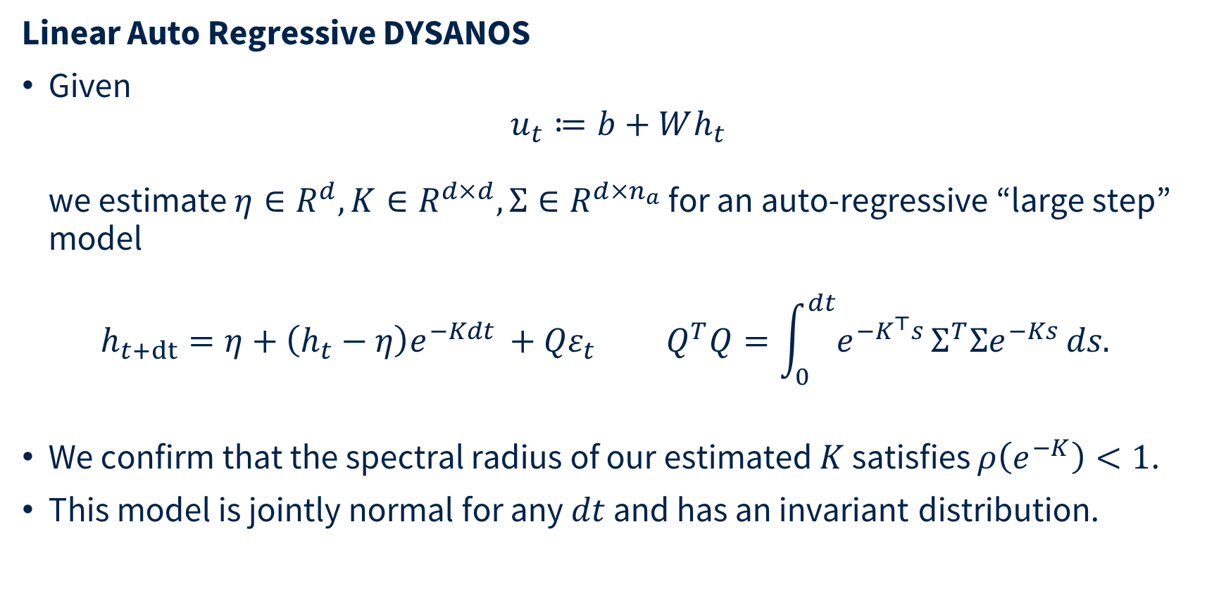
Linear Auto Regressive DYSANOS
Linear Auto Regressive DYSANOS
Given
$u_{t}≔b+Wh_{t}$
we estimate $η∈R^{d}, K∈R^{d×d},Σ∈R^{d×n_{a}}$ for an auto-regressive “large step” model
$h_{t+dt}=η+\left(h_{t}−η\right)e^{−Kdt }+{Qε}_{t} Q^{T}Q=\int_{0}^{dt}{e^{−K^{⊤}s}}Σ^{T}Σe^{−Ks} ds.$
We confirm that the spectral radius of our estimated $K$ satisfies $ρ\left(e^{−K}\right)<1$.
This model is jointly normal for any $dt$ and has an invariant distribution.

Slide 23
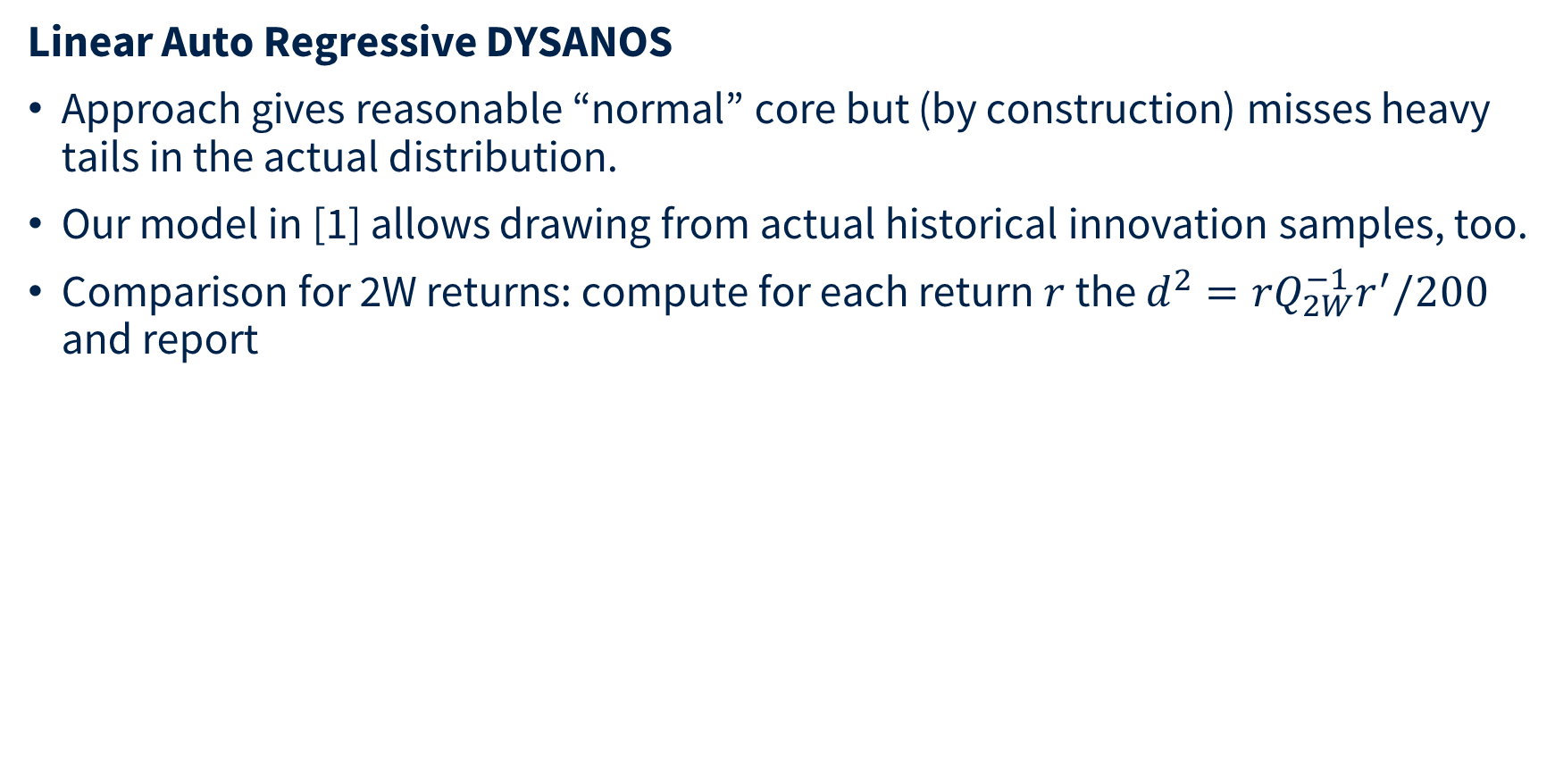
Linear Auto Regressive DYSANOS
Linear Auto Regressive DYSANOS
Approach gives reasonable “normal” core but (by construction) misses heavy tails in the actual distribution.
Our model in [1] allows drawing from actual historical innovation samples, too.
Comparison for 2W returns: compute for each return $r$ the $d^{2}=rQ_{2W}^{−1}r^{′}/200$ and report
 | Returns | RMSE | Mean | Median | q95 | q99 | Above Market q95 | Above Market q99
Market | 857 | 0.953 | 0.921 | 0.865 | 1.488 | 2.008 | 5.02% | 1.05%
Sampling Mode | 1,000,000 | 0.965 | 0.927 | 0.883 | 1.378 | 1.689 | 2.70% | 0.476%
Normal Mode | analytic | 0.996 | 1.000 | 0.997 | 1.170 | 1.247 | 0.001% | 0%

Slide 24
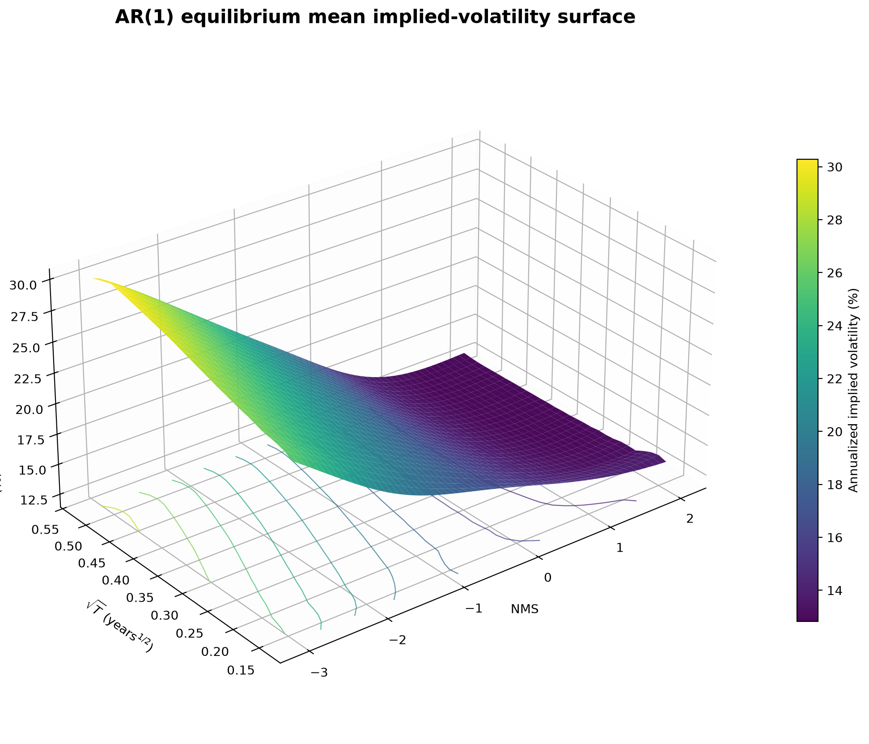
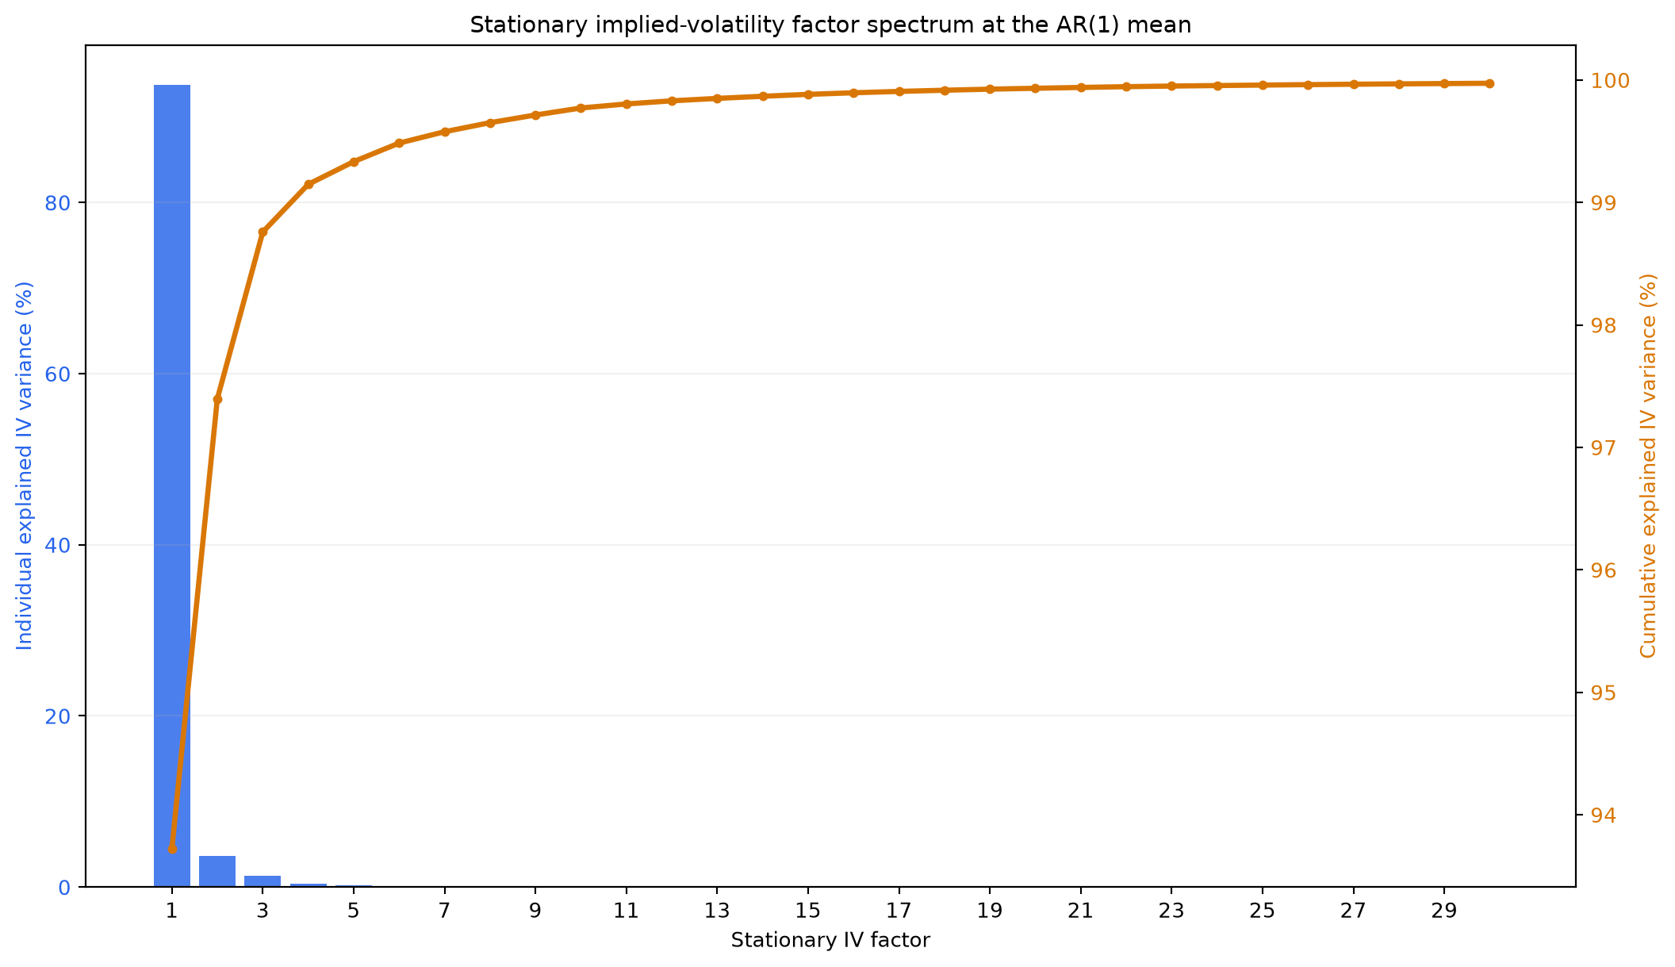
Linear Auto Regressive DYSANOS

Slide 25
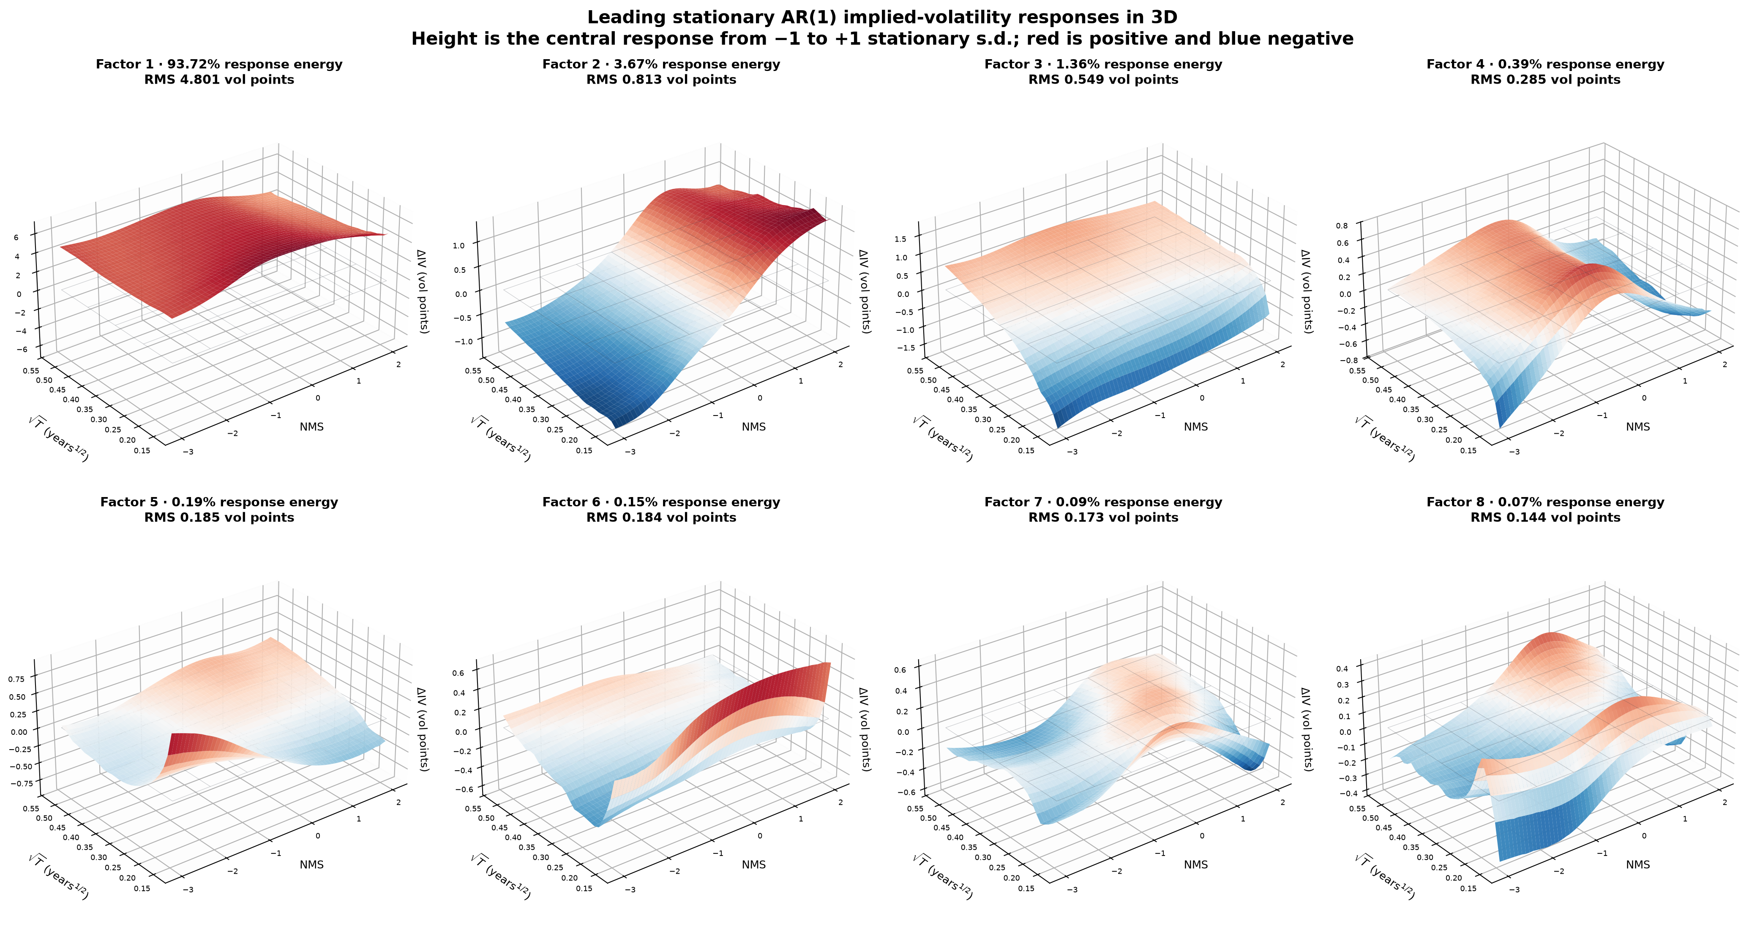
Linear Auto Regressive DYSANOS

Slide 26
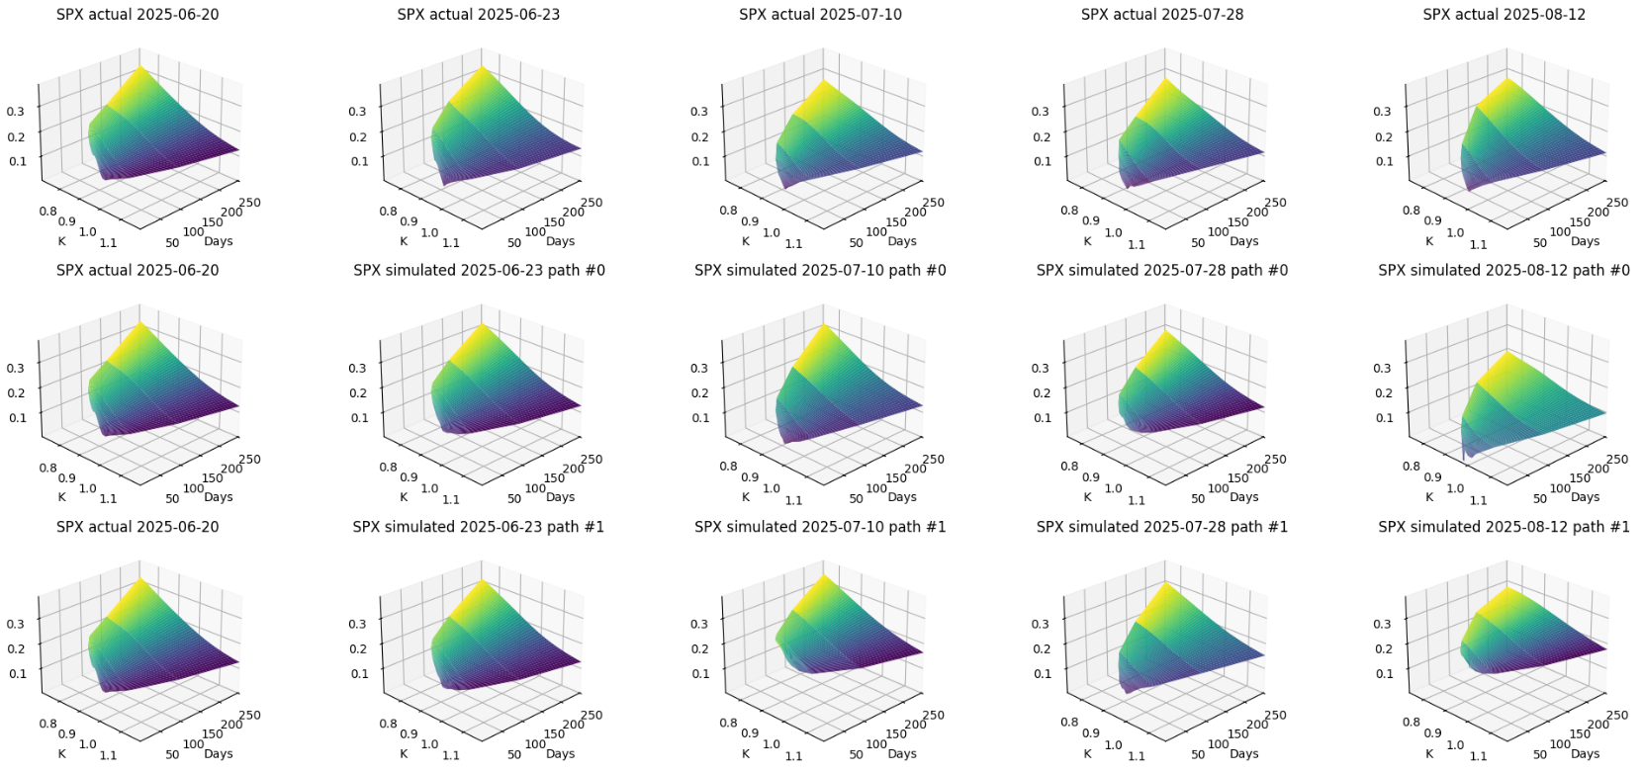
Generative SANOS
Vol simulated vs actual: top is actual, the other two sampled.
Eight business day steps between each shown surface
Actual
Simulated

Slide 27
Dynamic Arbitrage

Slide 28
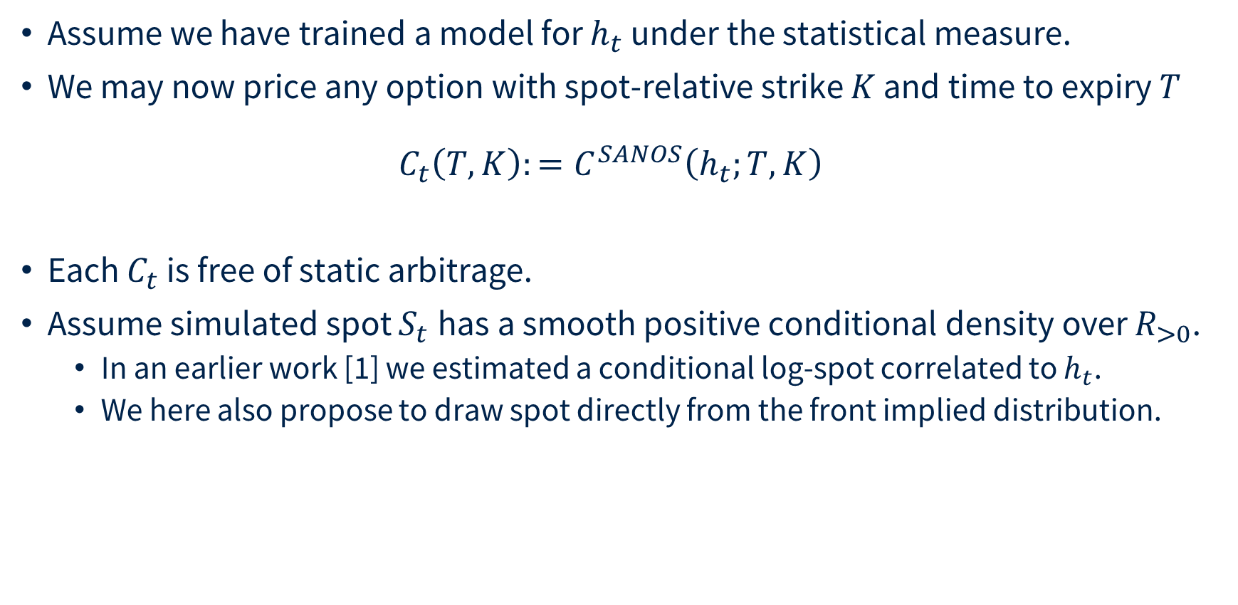
Dynamic Arbitrage
Assume we have trained a model for $h_{t}$ under the statistical measure.
We may now price any option with spot-relative strike $K$ and time to expiry $T$
$C_{t}\left(T,K\right):=C^{SANOS}\left(h_{t};T, K\right)$
Each $C_{t}$ is free of static arbitrage.
Assume simulated spot $S_{t}$has a smooth positive conditional density over $R_{>0}$.
  In an earlier work [1] we estimated a conditional log-spot correlated to $h_{t}$.
  We here also propose to draw spot directly from the front implied distribution.
__
[1] Hans Buehler et al. DYSANOS Generative Dynamic Smooth Arbitrage-free Non-parametric Option Surfaces, 2026 https://arxiv.org/abs/2608.12587

Slide 29
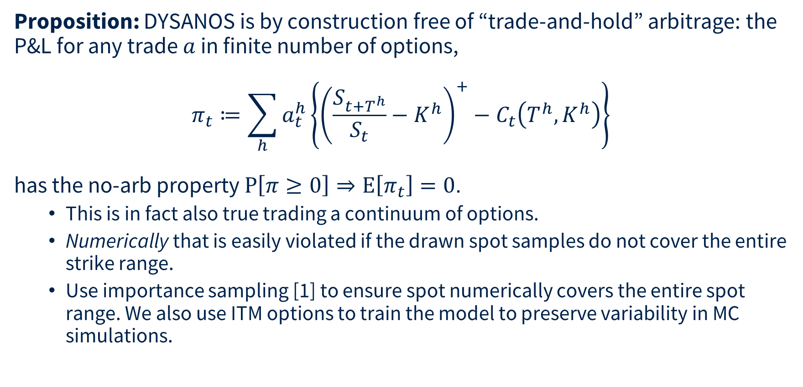
Dynamic Arbitrage
Proposition: DYSANOS is by construction free of “trade-and-hold” arbitrage: the P&L for any trade $a$ in finite number of options,
$$π_{t}≔\sum_{h}{a_{t}^{h}\left\{{\left(\frac{S_{t+T^{h}}}{S_{t}}−K^{h}\right)}^{+}−C_{t}\left(T^{h},K^{h}\right)\right\}}$$
has the no-arb property $P\left[π≥0\right]⇒E\left[π_{t}\right]=0$.
  This is in fact also true trading a continuum of options.
  Numerically that is easily violated if the drawn spot samples do not cover the entire strike range.
  Use importance sampling [1] to ensure spot numerically covers the entire spot range. We also use ITM options to train the model to preserve variability in MC simulations.
__
[1] Hans Buehler et al. DYSANOS Generative Dynamic Smooth Arbitrage-free Non-parametric Option Surfaces, 2026 https://arxiv.org/abs/2608.12587

Slide 30
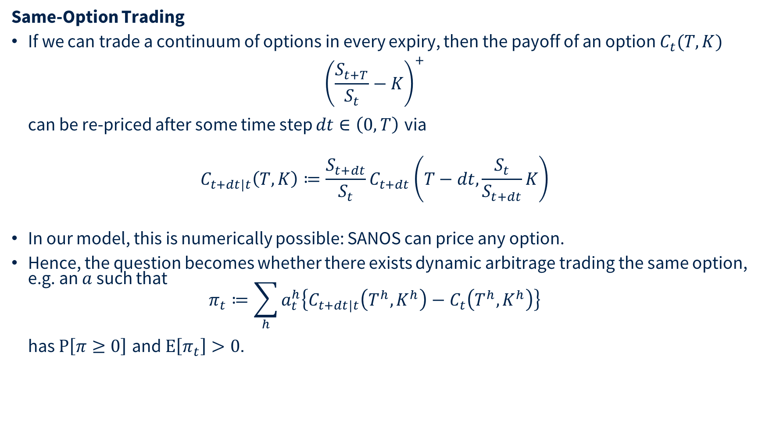
Dynamic Arbitrage
Same-Option Trading
If we can trade a continuum of options in every expiry, then the payoff of an option $C_{t}(T,K)$
${\left(\frac{S_{t+T}}{S_{t}}−K\right)}^{+}$
can be re-priced after some time step $dt∈\left(0,T\right)$ via
$C_{t+dt|t}\left(T,K\right)≔\frac{S_{t+dt}}{S_{t}}C_{t+dt}\left(T−dt,\frac{S_{t}}{S_{t+dt}}K\right)$
In our model, this is numerically possible: SANOS can price any option.
Hence, the question becomes whether there exists dynamic arbitrage trading the same option, e.g. an $a$ such that
$π_{t}≔\sum_{h}{a_{t}^{h}\left\{C_{t+dt|t}\left(T^{h},K^{h}\right)−C_{t}\left(T^{h},K^{h}\right)\right\}}$
has $P\left[π≥0\right]$ and $E\left[π_{t}\right]>0$.

Slide 31
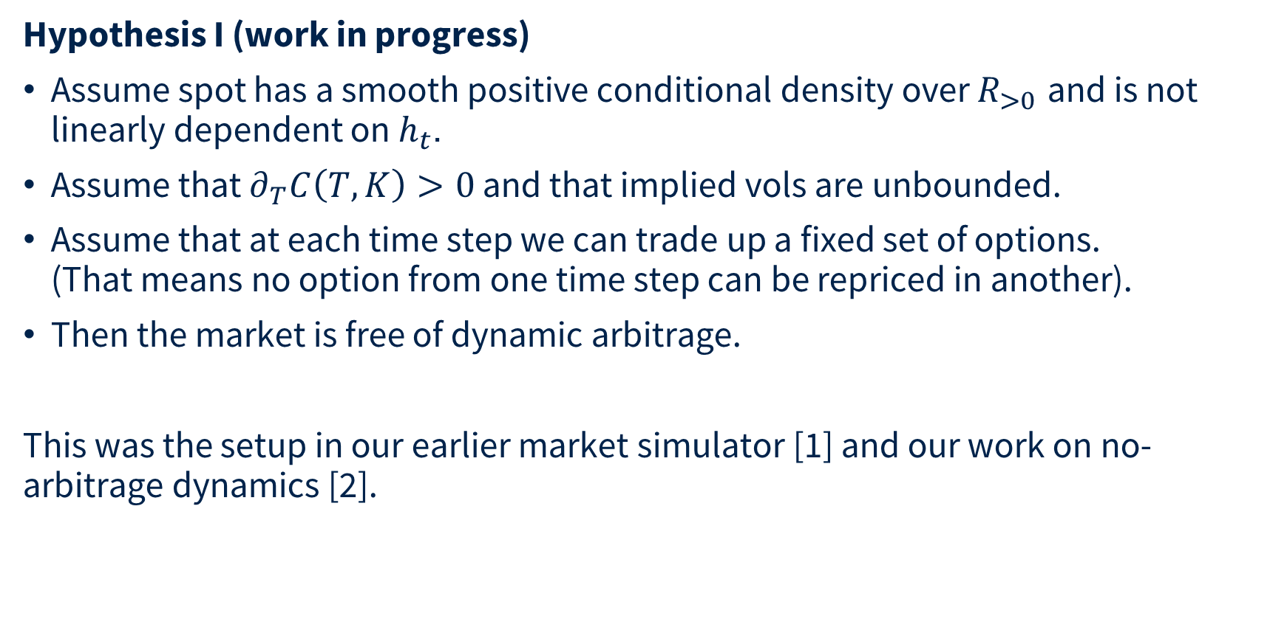
Dynamic Arbitrage
Hypothesis I (work in progress)
Assume spot has a smooth positive conditional density over $R_{>0}$ and is not linearly dependent on $h_{t}$.
Assume that $∂_{T}C\left(T,K\right)>0$ and that implied vols are unbounded.
Assume that at each time step we can trade up a fixed set of options.
(That means no option from one time step can be repriced in another).
Then the market is free of dynamic arbitrage.
This was the setup in our earlier market simulator [1] and our work on no-arbitrage dynamics [2].
__
[1] Multi-Asset Spot and Option Market Simulation, Wiese et al 2021 https://arxiv.org/abs/2112.06823
[2] Deep hedging: learning to remove the drift, Buehler et al 2022 https://www.risk.net/cutting-edge/banking/7932226/deep-hedging-learning-to-remove-the-drift and https://arxiv.org/abs/2111.07844

Slide 32
Dynamic Arbitrage
Hypothesis II (work in progress)
We can find a measure such that DYSANOS is fully dynamically arbitrage free for a pre-specified finite number of options.
Status
The challenge is that strict arbitrage is numerically very hard to distinguish from a very good trade. That means [1] fails numerically here.
Need a clean concept of numerical absence of arbitrage. It is sufficient if the conditional expectation is statistically indistinguishable from zero.
Incorporate this into a robust learning process.
__
[1] Deep hedging: learning to remove the drift, Buehler et al 2022 https://www.risk.net/cutting-edge/banking/7932226/deep-hedging-learning-to-remove-the-drift and https://arxiv.org/abs/2111.07844

Slide 33
Generative “DYSANOS” V1.1
Summary
  Define a discrete, smoothed version of local vol.
  Express in real-valued coordinates.
  Encode it via some 200-dimensional candidate state.
  PCA with 8 factors → believable normal dynamics but misses heavy tails.
  Change measure → risk neutral.
What next
  Free instrument choice in Deep Hedging.
  Better dynamics than AR1 PCA.

Slide 34
Please ask questions
hans.buehler@maths.ox.ac.uk

